Slide 1
Feature Evolution Based Multi-Task Learning for Collaborative Filtering with Social Trust
1
Qitian Wu , Lei Jiang, Xiaofeng Gao, Xiaochun Yang, Guihai Chen
Department of Computer Science and Engineering, Shanghai Jiao Tong University
Notes:
Good afternoon, ladies and gentlemen! My name is Jinning Li, xxx (self introduction). I will help the author Qitian Wu to present the work Feature Evolution Based Multi-Task Learning for Collaborative Filtering with Social Trust.

Slide 2
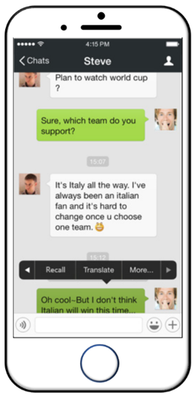


Problem Background
Social Network Service
①
②
Recommender System
① Users with similar preferences tend to become friends
② Friends tend to have similar behaviors
Notes:
We first start with the problem background. In our daily life, we frequently interact with social network services and recommender systems everyday. The most popular social network services include Facebook, Twitter and Wechat, while recommender systems are pervasive in all kinds of platforms with the aim for music, movies, articles, news and even academic papers. There are two common phenomenon among the interaction of users with the recommendation. One is that the interacting behaviors always reflect the inner preferences of one user and users with similar preferences tend to become friends in social network. Another is that two friend users tend to have similar preferences and do similar interaction behaviors in the recommender system, like clicking on the same article.

Slide 3
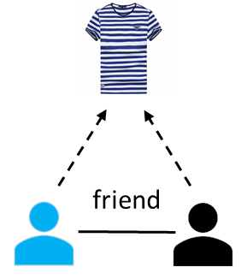
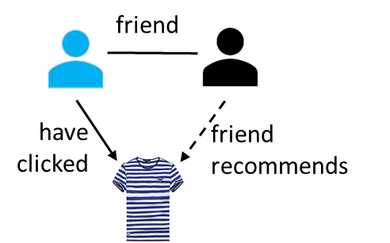
Problem Background
Social Homophily
Social Influence
Heterogeneous
Different strengths w.r.t different friends
Dynamic
Different strengths w.r.t different contexts
We need a model to better leverage social information to exactly compensate the recommendation tasks
Notes:
We term these two phenomenon as social homophily and social influence. To step further, the social homophily and influence would be heterogeneous and dynamic. The heterogeneity is because different friends have different strengths while the dynamic property means that under different contexts the influence would change. Hence, to better leverage such social information and capture its interaction with the behaviors in recommendation, we need a model that is good at expressing this heterogeneous and dynamic properties.

Slide 4
Related Work
Trust Propagation
Use the rating/clicking of friends to estimate the rating/clicking of the targeted user
Trust Matrix Factorization
Adopt latent user preference factor to retrieve the matrix of social trust
Trust Graph Regularization
Constrain the representations of neighbored users in social network to be similar
Trust Network Embedding
Treat user-item interaction network and social network as a whole network and use network embedding to encode the topology information as low-dimension features
1) Assume a common feature space for user preference and trust
Limitations
2) Model social influence as static weight or fixed constraints
Notes:
There are plenty of previous works concentrating on this problem and we can divide them into four categories. The first one is trust propagation, it uses the rating or clicking of friends to estimate the behaviors of the targeted users. The second one we call it trust matrix factorization which assumes latent user preference factor to retrieve the matrix of social network. The next method is trust graph regularization, it constrains the representations of neighbored users in social network to be similar, which is motivated by the social homophily mentioned in previous slide. The last one is trust network embedding, it treats user-item interaction network and social network as a whole network and user some network embedding techniques to encode the topology information as low-dimensional features. However, these previous works share some common limitations. Firstly, they assume a common feature space for user reference and trust. Secondly, they tend to model the social influence as static weight or fixed constraints. Such operations would limit the expressive power of model and fail to capture the heterogeneity and dynamic of social influence.

Slide 5
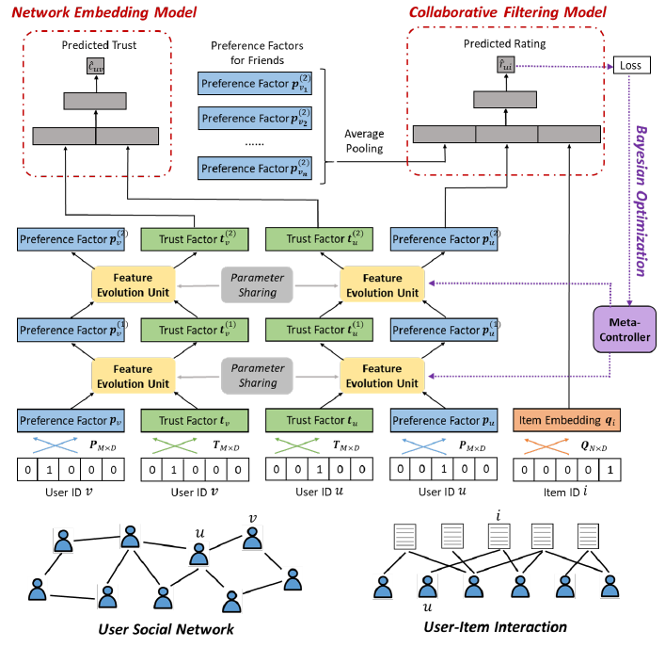


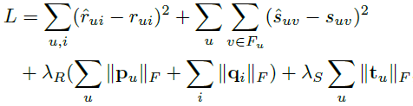
Our Model: TrustEV
Two core novel units
Embedding Layer
User preference embedding
User trust embedding
Item embedding
Collaborative Filtering Model
Network Embedding Model
Loss Function for Two Tasks
Notes:
To tackle this issue, we propose a model named TrustEV. Specifically, we first assume two separate embedding vectors for user preference and user trust information. Then the two embedding vectors of one user would go through a special feature evolution unit. Such unit outputs a vector that synthesizes the information of two and captures their element-wise interaction. Then the user embedding and item embedding would be used as the input of two models, one is for network reconstruction of user social network, another is for collaborative filtering in recommendation. The final loss would be the sum of two tasks. Besides, since each feature evolution unit has a series of parameters, we designs a meta-controller to automatically search for an optimal settings for the hyperparameters in the feature evolution unit. I will go into the details in the following.

Slide 6
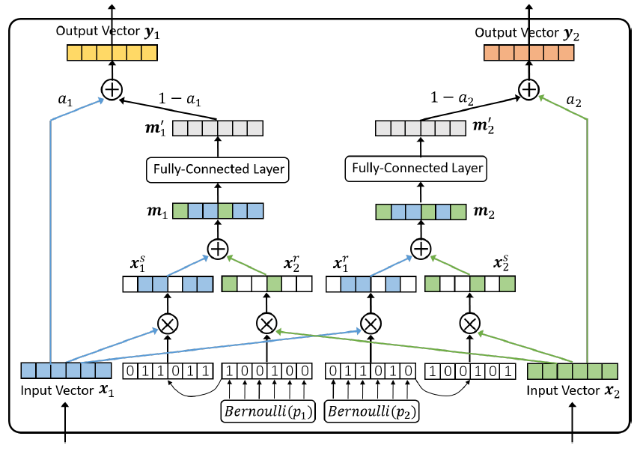
Details for Feature Evolution Unit
Notes:
In the feature evolution unit, we first assume two Bernoulli distribution which would determine which element in the input vector would be replaced by the element in another input vector. Then the partially interacted features would go through a fully-connected layer to get a more dense representation. The stochastic cross feature operation can help to capture the dynamic influence of social network on user preference.

Slide 7

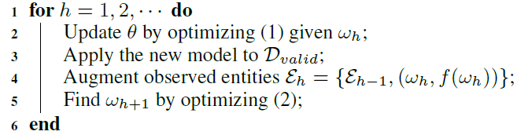
Details for Meta-Controller with Bayesian Optimization
Model the loss on validation dataset as a Gaussian Process:
Our goal is to minimize the loss w.r.t all hyper-parameters:
Optimization Algorithm for TrustEV
Notes:
As for the meta-controller, we model the sequence of losses given by different settings of feature evolution units on the validation dataset as a Gaussian process and our goal is to minimize the loss with regard to the hyperparameters in the feature evolution units. Here we use a UCB acquisition function to get the updating strategy. Hence, the final optimization algorithm contains two-loops, where the outer loop is to search for updating the hyper-parameters and the inner loop is to optimize the network given a set of hyper-parameters.

Slide 8
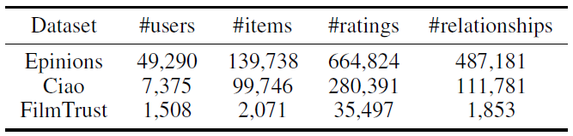
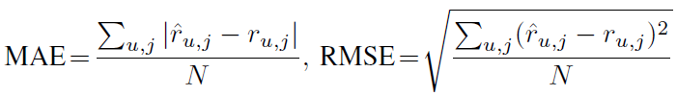
Experiment Setup
Data Set Information
Evaluation Protocol
Randomly select 70% for training, 20% for validation, 10% for testing
Implementation Details
Use Python with Tensorflow to implement the codes
Notes:
We deploy the experiments on three datasets. For evaluation, we randomly select 70% for training, 20% for validation, 10% for testing, and user MAE and RMSE as the metric. We use Tensorflow to implement the method

Slide 9
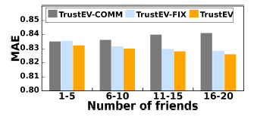
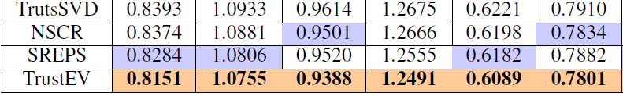
Experiment Results
TrustSVD trust matrix factorization method
Comparative methods
NSCR trust graph regularization method
SREPS trust network embedding method
TrustEV-COMM remove feature evolution units
Ablation-Study methods
TrustEV-FIX remove meta-controller
TrustEV our model
Notes:
We also compare our method with some other works, like Trust SVD, a trust matrix factorization method, NSCR, a trust graph regularization method, SREPS, a trust network embedding method. For ablation-study, we consider two surrogates, the first one removing the feature evolution unit and the second one removing the meta-controller. The results show that our method is better than other competitors and the proposed units are effective.

Slide 10
Conclusions
Problem:
Recommending items based on user social network
Our Contributions:
Proposed a special feature evolution unit to achieve information exchange between two features in a random manner
model heterogeneous and dynamic social influence
Design a Bayesian optimization based meta-controller to automatically search for the optimal hyper-parameter setting
better leverage the social information
Compare with different methods and show the superiority of our model
Notes:
Finally, we do a conclusion. In this work, we focus on taking advantaging of the social network to help recommendation. We proposed a special feature evolution unit to achieve information exchange between two features in a random manner, which could model heterogeneous and dynamic social influence. Then we design a Bayesian optimization based meta-controller to automatically search for the optimal hyper-parameter setting, that can better leverage the social information. At last, we run experiments over real-world datasets to verify the superiority of our model.

Slide 11
Thank you!
Q&A

